Slide 1
Cluster Operations

Slide 2
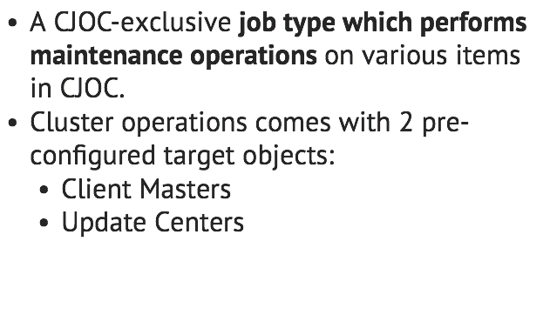
What is Cluster Operations?

Slide 3
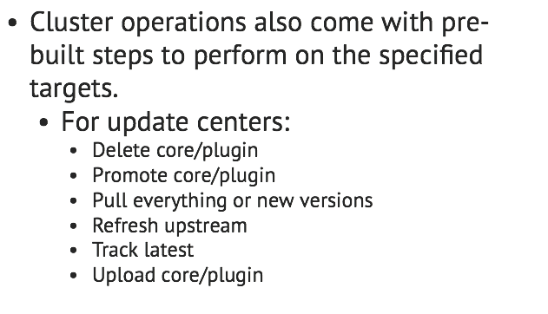
What is Cluster Operations?

Slide 4
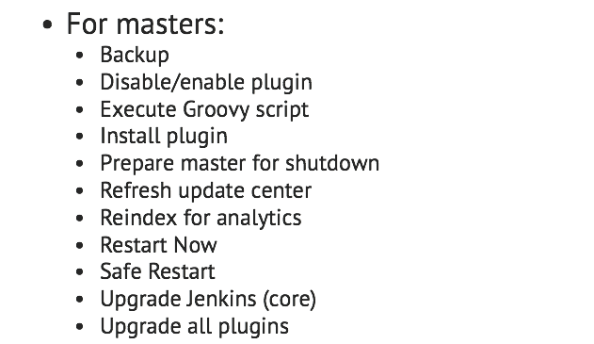
What is Cluster Operations?

Slide 5
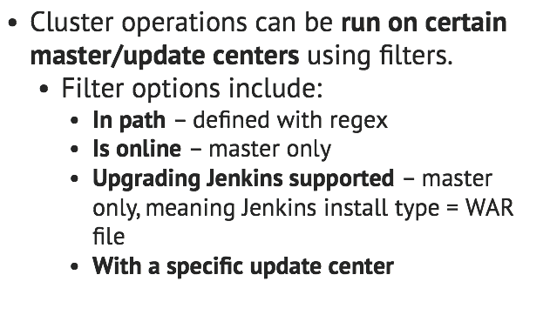
What is Cluster Operations?

Slide 6
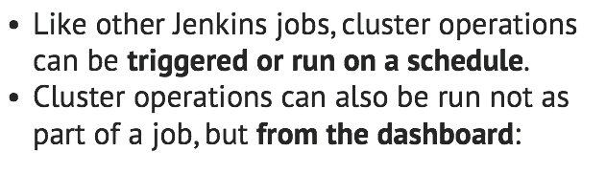
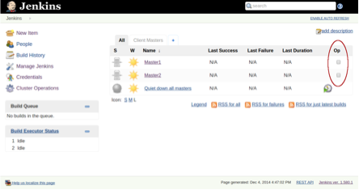
What is Cluster Operations?

Slide 7
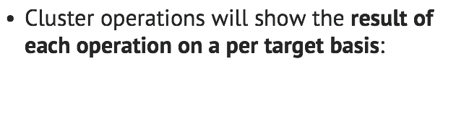
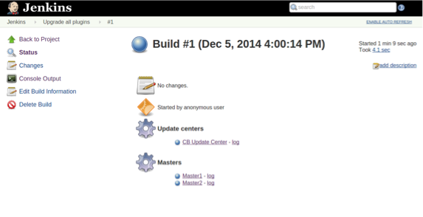
What is Cluster Operations?

Slide 8
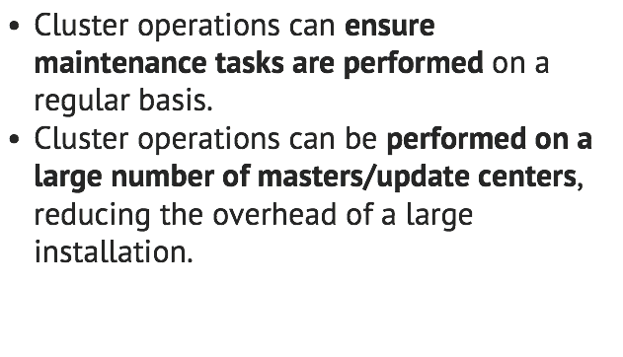
Benefits: maintainability

Slide 9
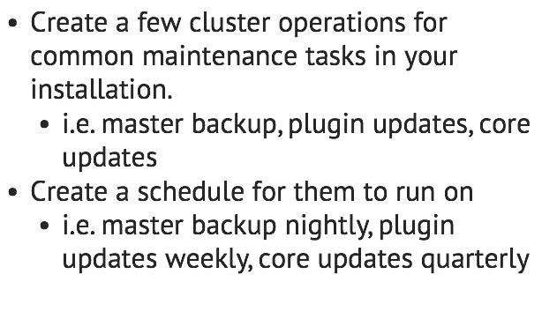
Where do we start?

Slide 10
Lab Exercise:
Setting up a plugin update Cluster Operation

